Slide 1
Writing a Report - C1 Advanced

Slide 2
Writing Part 2 - Report
The purpose of a report is to outline information gathered from:
An event
A program
A course
An experience
A survey
and make relevant recommendations for future improvements. You should give a detailed account of what you witnessed, both good and bad!

Slide 3



What you should include:
Inversions - (Not only/Seldom/No Sooner)
Inverted Conditional - (Were we to…)
Participle Clause - (Being…/ Having gone…)
Double Comparative - (The more we… the more…)
Passive Structures - (The committee has been informed about…)
Linkers - (Notwithstanding/However/So as to/Due to/Consequently)

Slide 4

What you should NOT include:
Descriptive and Colourful Writing - (Amazing/Lovely/Fantastic)
Idioms - (It was a piece of cake)
Phrasal Verbs - (Turn up/ Look for)
Contractions - (We’ve/ Don’t)
Personal Opinions - (I think that…/ I really liked…)

Slide 5
Introduction:
Example: Report on six-month progress as a teacher:
Introduction
The purpose of this report is to evaluate the progress following the first half year in my current position as an English Teacher as well as enumerate achievements outline issues and make suggestions for professional development measures.
The introduction must contain all the necessary information covered by the report:
appropriate beginning in which you should explain your purpose for writing your report The purpose of this report is to…..
The topic of the report (see step 1)
The three main key points that you discovered (see step 1)

Slide 6
Main Body:
Main key points (see step 1):
explain what you feel has been achieved
describe any problems
In the main content, you should comment on/answer the main key points that you discovered in the task (see step 1) under suitable subheadings (positive/negative points), and each is placed in a separate section/paragraph.

Slide 7
Conclusion:
Example: Report on six-month progress as a teacher:
Conclusion
In the final analysis, the situation of the teachers and students at our school is very likely to improve and overall satisfaction will probably increase due to more efficient work processes if ideas included in the report are implemented.
The conclusion should contain a final assessment of the report, providing information, conclusions and giving a final answer.

Slide 8
The first observation to make concerns…
Not only were the… but also..
Furthermore,…
Moreover,…
Silence is golden. Unless you have kids, then it’s suspicious.
It has to been stressed that…
According to (the majority of respondents)…
In spite of (the fact that)…
In conclusion,…
From the research one can conclude that…
Cook for 35 minutes at 180c
The outlook for …… is (far from)bright/optimistic/depressing/daunting
I would strongly recommend that…
The following measures should be implemented:
Take the tablet every 6-8 hours to relieve symptoms.
In the light of the results of the survey I would advise against…
The more the… the better/worse the…
Hey. So great to hear from you.
The purpose of this report is to outline…
Given the results of the survey, I would advise for…
Despite (the fact that)…
Every sixty seconds in Africa, a minute passes.
Had they been… they would have…
Provided that these recommendations are taken into consideration,…
In conclusion,…
From the research one can conclude that…
Were it to repeat… it should…
The future looks bleak/remains uncertain/is promising
This seems unlikely in the near/foreseeable future
I feel it would be to our advantage if…
The best solution would be to…
In order to improve …… it is necessary to..
Life is a bowl of soup, and I’m a fork.

Slide 9
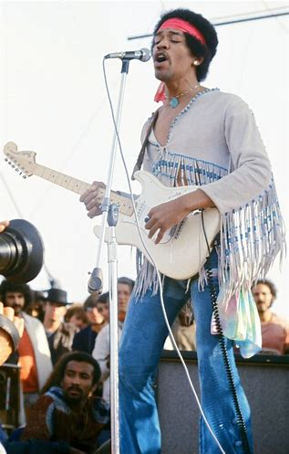
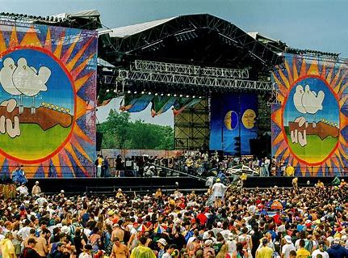
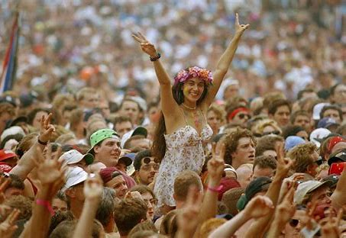
Woodstock 1969

Slide 10
Woodstock 1969
The Woodstock Music Festival began on August 15, 1969, as half a million people waited on a dairy farm in Bethel, New York, for the three-day music festival to start. Billed as “An Aquarian Experience: 3 Days of Peace and Music,” the epic event would later be known simply as Woodstock and become synonymous with the counterculture movement of the 1960s. Woodstock was a success, but the massive concert didn’t come off without a hitch: Last-minute venue changes, bad weather and the hordes of attendees caused major headaches. Still, despite—or because of—a lot of sex, drugs, rock ‘n’ roll and rain, Woodstock was a peaceful celebration and earned its hallowed place in pop culture history.

Slide 11
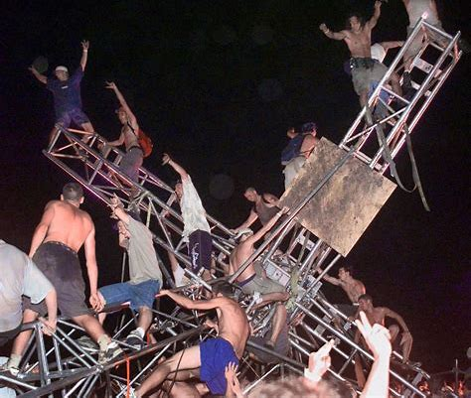
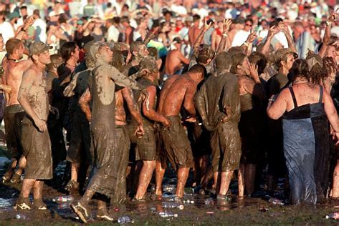
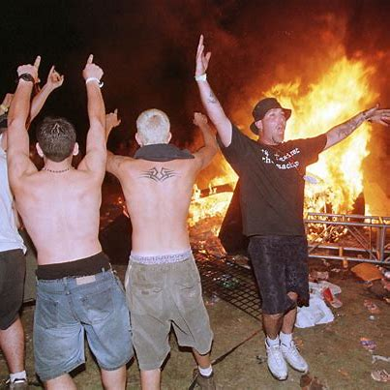
Woodstock 1999

Slide 12
Woodstock 1999
After the success of the first Woodstock festival, the organisers decided to repeat it, hoping it would be just as historically and culturally successful… It wasn’t.

Slide 13
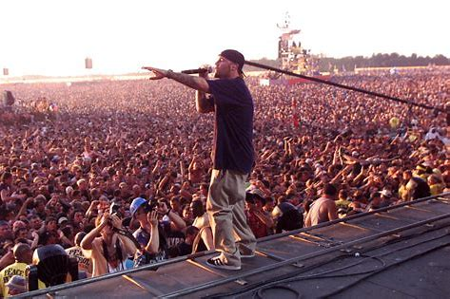
Watch the short video (10mins) and complete the table.
https://www.youtube.com/watch?v=gH6-nBwOwkA
Imagine you were present at the festival. Make notes in each section about what was done well… or badly.
Location | Food and Drink | Music | Staff and Facilities

Slide 14
Recommendations:
In light of the events that transpired regarding… , I’d recommend/advise against…
The following measures should be implemented:
If we were to repeat the festival, we should…
In order to improve… , it is necessary to…
Provided that these recommendations are taken into consideration…

Slide 15
Homework
You have just finished a three-week study and work programme in an English-speaking country. You studied English language in the mornings and worked for a local company in the afternoons. The programme organiser has asked you to write a report about your experience. In your report, you should evaluate the programme, explaining which part of the programme was more useful, and suggest changes you would recommend for next year’s programme.
Write your report

Slide 16
What people are saying
With this app, I’m confident to plan a trip to rural Vietnam
Wendy Writer, CA
Visual translation feels like magic
Ronny Reader, NYC
Translate has officially inspired me to learn French
Abby Author, NYC
Quotes for illustration purposes only

